Slide 1


Cloud Computing

Slide 2



KAZI ABDULLAH JARIF id- 22-46386-1

Slide 3



Introduction: What is Cloud ?

Slide 4
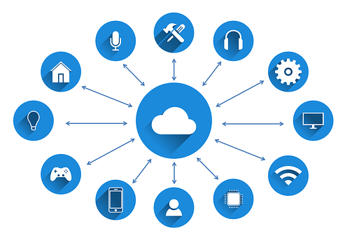
What is Cloud Computing ?

Slide 5
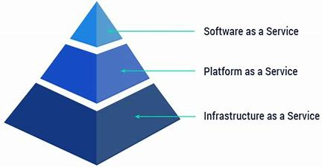

Types of Cloud Computing Providers:
There are three kinds of cloud computing providers –
1. Infrastructure as a Service (IaaS),
2. Platform as a Service (PaaS) ,
3.Software as a Service (SaaS).

Slide 6
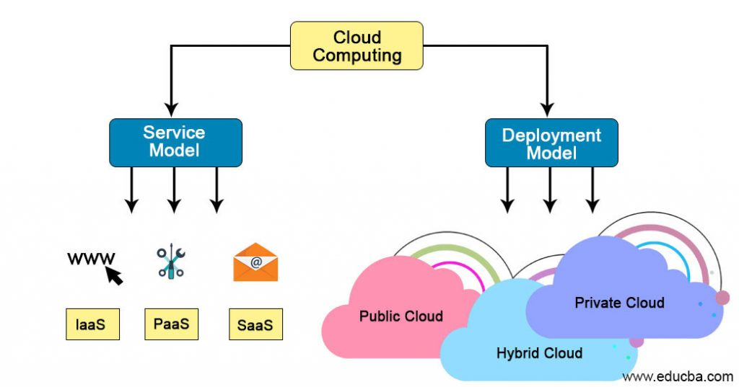

Slide 7


Deployment model:
Public cloud
Hybrid cloud
Private cloud

Slide 8
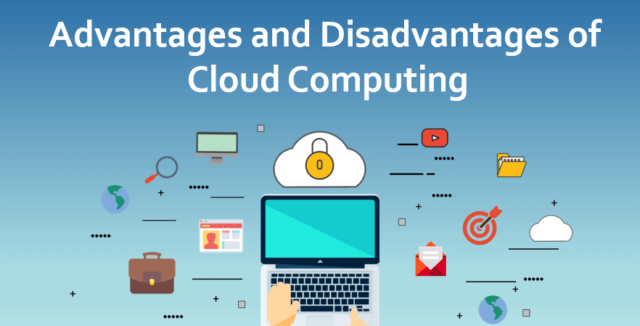

Slide 9

Advantages:
Reduce costs.
Improved Performance , Computing power & maintenance.
Instant software updates.
Unlimited storage capacity.
Increased Data Safety.
Compatible on any operating system.
Can use any devices on same account.

Slide 10



Requires a constant Internet connection. Doesn’t work with low connection . Stored data might not be secure. Cloud might lose your data.

Slide 11
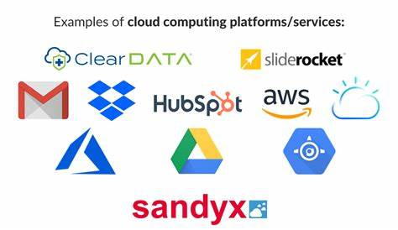
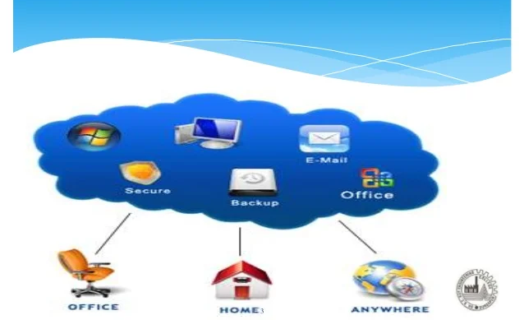
Examples of Cloud computing:
Dropbox, Facebook, Gmail
Banking, Financial Services
Health Care
Education
Government
Big data Analytics
Communication
Business Process

Slide 12

Conclusion:
The popularity of cloud computing is grooming day by day due to its numerous benefits. The ability to avoid expensive software license costs is one of the factors that enables companies to provide cloud services. They are Internet based Cloud resources are available over the network anytime and are accessed through a standard mechanism that promotes use by different types of platforms (e.g.: mobile phones, laptops, and PDAs). They also help in e-learning by providing many services online for education.

Slide 13


